Slide 1


SQL PROJECT
PIZZA HUt

Slide 2


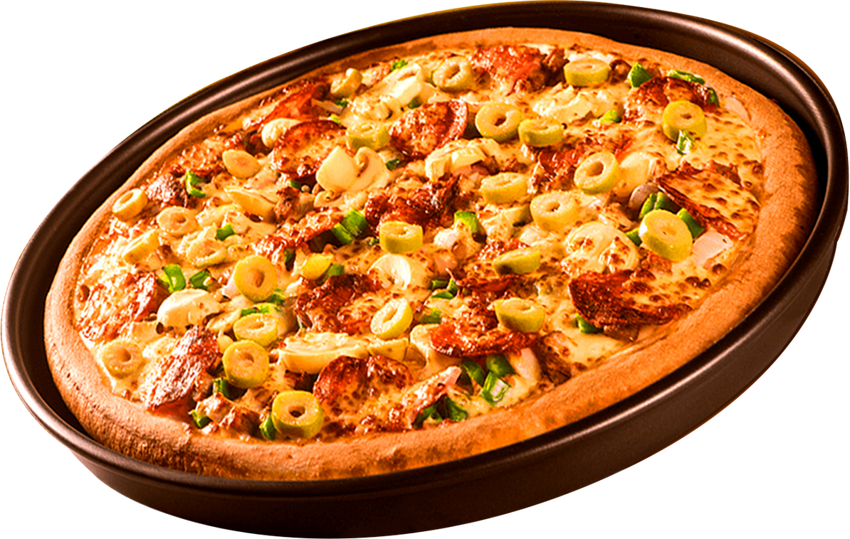

SQL Project
welcome to
PIZZA HUT
Objective: Analyze pizza sales data using SQL to uncover sales trends, customer preferences, and overall business performance.
Goal: Help the business make data-driven decisions for better sales strategy and customer targeting.

Slide 3


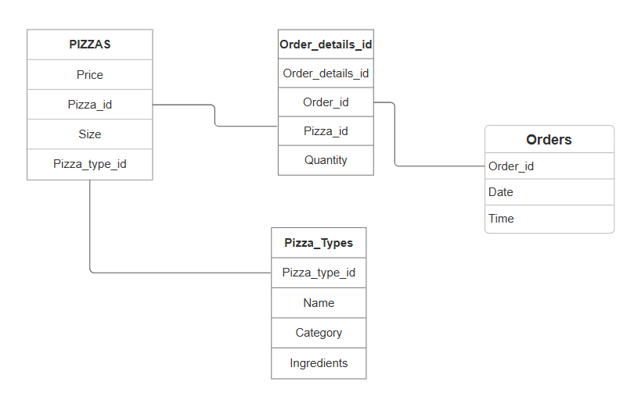
pizza Hut
ER-Diagram

Slide 4
pizza hut
SAMPLE SQL QUERIES
Retrieve the total number of orders placed.
Calculate the total revenue generated from pizza sales.
Determine the top 3 most ordered pizza types based on revenue.
Calculate the percentage contribution of each pizza type to total revenue.
Analyze the cumulative revenue generated over time.
Determine the top 3 most ordered pizza types based on revenue for each pizza category.

Slide 5
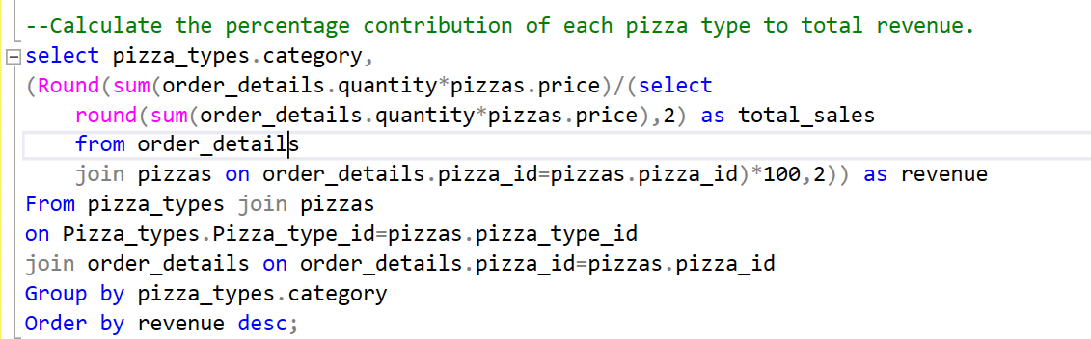
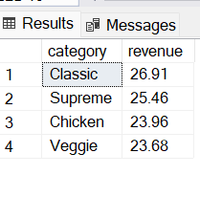
Pizza hut
Query for Total Revenue

Slide 6



pizza hut
CATEGORY- REVENUE
$6
$8

Slide 7


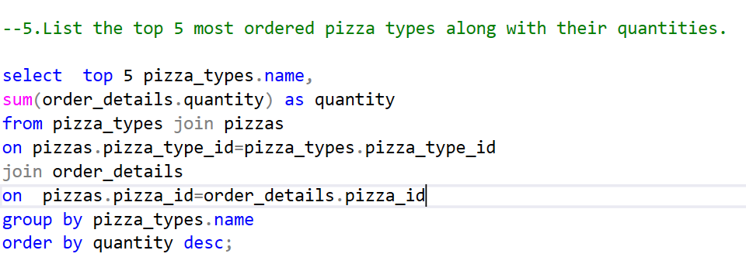
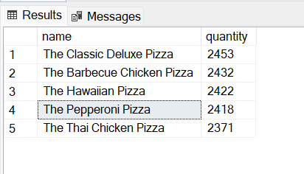
Most Ordered Pizza

Slide 8


Conclusion
pizza hut
Conclusion:
The analysis of pizza sales data provides valuable insights into customer behavior, sales trends, and product performance.
By leveraging this information, businesses can optimize marketing efforts, improve customer retention, and refine inventory strategies to maximize sales.
Data-driven decisions are essential for staying competitive in the pizza market, ensuring growth, and meeting customer preferences.

Slide 9
Pizza hut
thank you!

